Slide 1


Session 6

Slide 2

Session Overview
Outcomes
The team will create a mission strategy plan and write pseudocode for a mission.
The team will conduct research on their identified problem and start the Innovation Project Planning page.
Notes:
Facilitator Tips

Slide 3

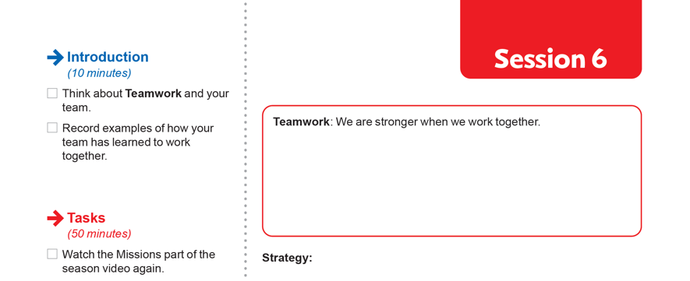

Introduction
Think about Teamwork and your team.
Record examples of how your team has learned to work together.
Notes:
Facilitator Tips
The team should be able to describe what everyone’s strong points are and why they like working with them.

Slide 4

Pseudocode & Strategy
Watch the Missions part of the season video again.
Visit the
FIRST® LEGO ® League
YouTube Channel
to watch the
CARGO CONNECT season video
Notes:
Facilitator Tips
Mission videos can be found in the Interactive Robot Game Rulebook too!

Slide 5
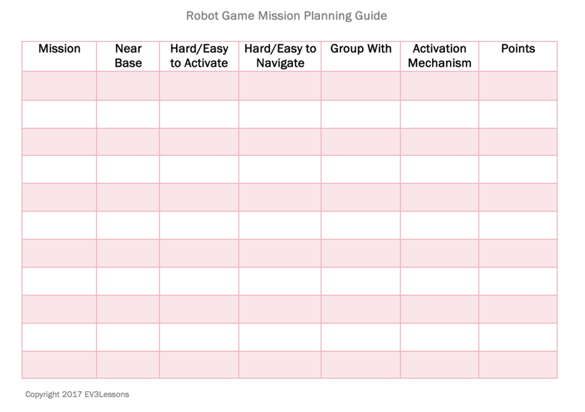
Pseudocode & Strategy
Start to think about your mission strategy.
Design an effective work plan.
Discuss which missions your team will attempt first.
Example from Droid Robotics (flltutorials.com)
Notes:
Facilitator Tips
Provide sticky notes and planning cards for team to place on the mat to map out their mission strategy.
Encourage the team to find the missions where points can be scored most easily and do these first.

Slide 6
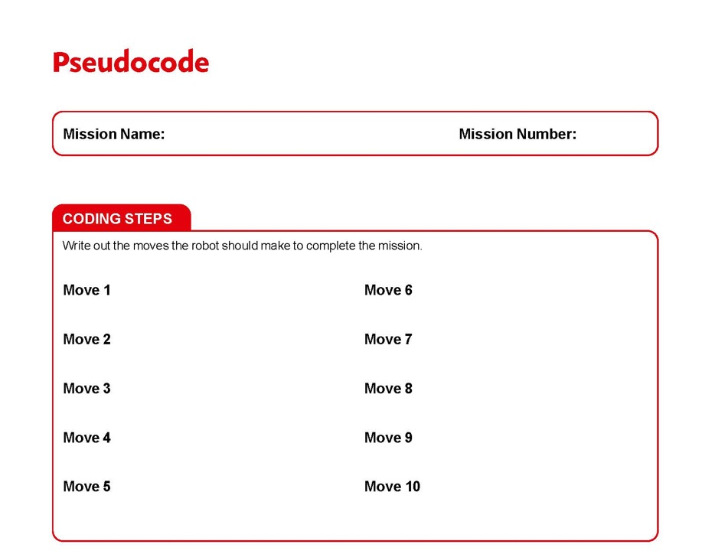
Pseudocode & Strategy
Complete the Pseudocode page.
Notes:
Facilitator Tips
More copies of the Pseudocode page can be photocopied. They can be used for each mission the team attempts.

Slide 7
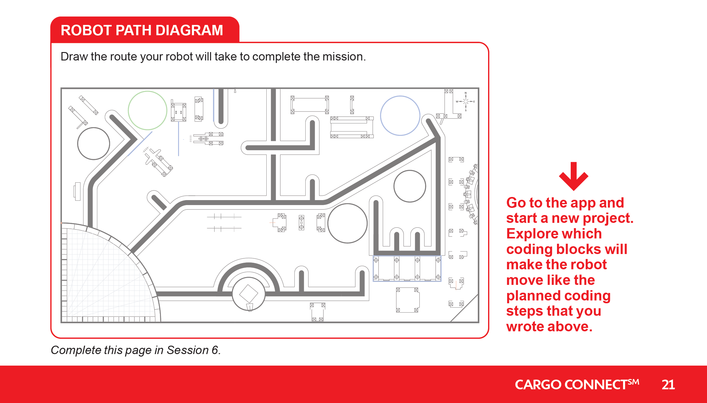
Pseudocode & Strategy

Slide 8


Pseudocode & Strategy
Think about how the program will make your robot act.
Revisit the earlier lessons or do the optional lesson listed below.
Amend the guided mission code so it works on the advanced driving base.
Notes:
Facilitator Tips

Slide 9

Pseudocode & Strategy
Reflection Questions
What does your robot need to do to complete the first mission you have chosen?
What is your Robot Game strategy to complete missions?
Pseudocode is written steps for your planned robot program.

Slide 10
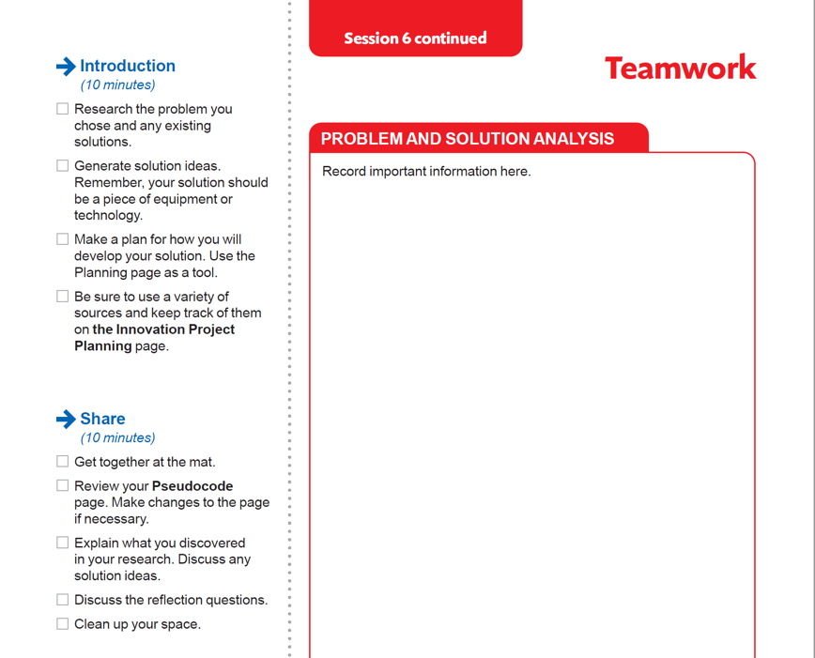
Teamwork
Research the problem you chose and any existing solutions.
Generate solution ideas. Remember, your solution should be a piece of equipment or technology.
Make a plan for how you will develop your solution. Use the Planning page as a tool.
Be sure to use a variety of sources and keep track of them on the Innovation Project Planning page.
Notes:
Facilitator Tips
Be sure the team collects their sources in a shared location, either online or on paper.
Take some extra time with the team if needed to explore all the solution ideas and narrow it down to one.
Make sure their solution has the potential to be developed and they can explain their solution clearly.
The Innovation Project Planning page can be completed over multiple sessions and helps the team document their process.

Slide 11
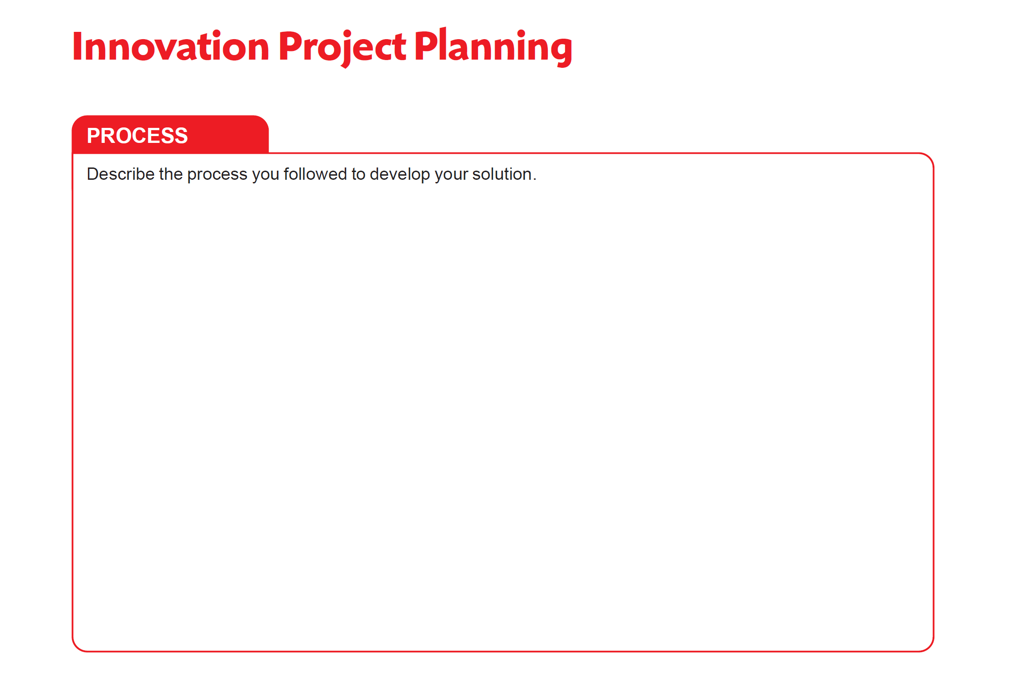
Notes:
Facilitator Tips

Slide 12
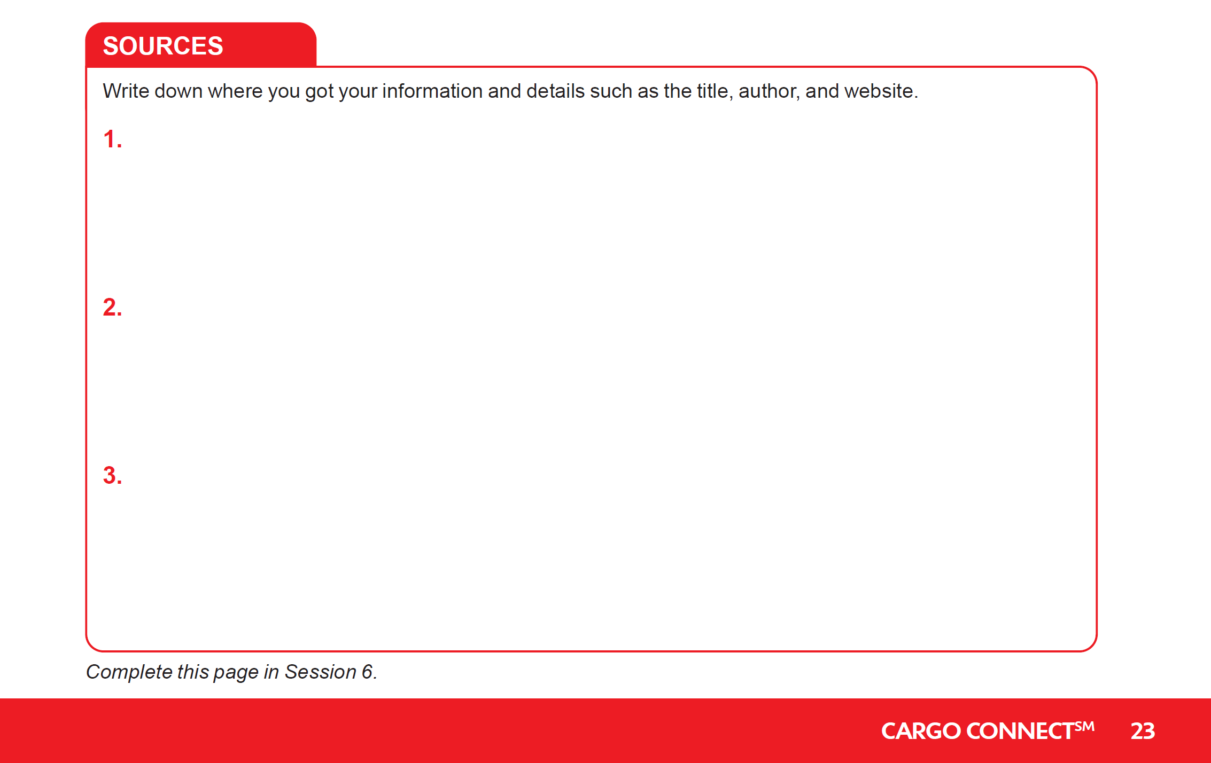
Notes:
Facilitator Tips

Slide 13

Guiding Questions
What information are you looking for?
Does this source have information relevant to your project?
Can you use different types of sources such as credible Internet websites, books, and experts?
Is this a good and accurate source of information?
Notes:
Facilitator Tips

Slide 14
Share
Get together at the mat.
Review your Pseudocode page. Make changes to the page if necessary.
Explain what you discovered in your research. Discuss any solution ideas.
Discuss the reflection questions.
Clean up your space.

Slide 15

Reflection Questions
Are there existing solutions to your identified problem that you could improve?
Do you have brand-new solution ideas to your problem?

Slide 16

Career Connections
Warehouse Worker
Role:
Sorts products and place into boxes for shipping.

Slide 17

Multimedia Resources
You may wish to embed a relevant, age-appropriate video for your students here. See the Notes for an example.
Notes:
Choose a relevant, age-appropriate video for your students.
Here is one example:
How Robots Can Assist - Not Replace - Humans in Factories from CNBC Length 8:43
https://youtu.be/hhBSaVsMvgE

Slide 18

Clean Up

Slide 19

FIRST® and the FIRST® logo are registered trademarks of For Inspiration and Recognition of Science and Technology (FIRST). LEGO® and MINDSTORMS® are registered trademarks of the LEGO Group. FIRST® LEGO® League and CARGO CONNECTSM are jointly held trademarks of FIRST and the LEGO Group. SPIKE™ Prime is a trademark of LEGO® Education. All other trademarks are the property of their respective owners. ©2021 FIRST and the LEGO Group. All rights reserved.

